Slide 1
Retinanet
AI-Driven Multi-Class Eye Disease Detection and Classification System
Team Details (Group No - 16):
Palaniselvam Priyanka (Team Leader) A0307250R
2. Dharshini Chellappa Chetty Rajan A0307202X
3. Sweta Pattnaik A0296537M

Slide 2
PROJECT OBJECTIVES AND SCOPE
In many developing countries, access to timely and accurate medical care remains a significant challenge, particularly in specialized fields like ophthalmology. The delays in diagnosis and limited availability of expert consultations often lead to the progression of preventable or treatable eye conditions, exacerbating the burden of vision-related disabilities.
This project is essential because it aims to bridge the gap in access to eye care by leveraging advanced technology to accelerate the detection of eye diseases by providing instant diagnosis and feedback to medical professionals and patients, even those in remote areas.
The project aims to build a robust classification system capable of identifying eye ailments and providing detailed diagnostic information. It uses machine learning and deep learning techniques to diagnose and classify various eye diseases such as Diabetic Retinopathy, Cataract, Glaucoma, etc. using retinal images.

Slide 3
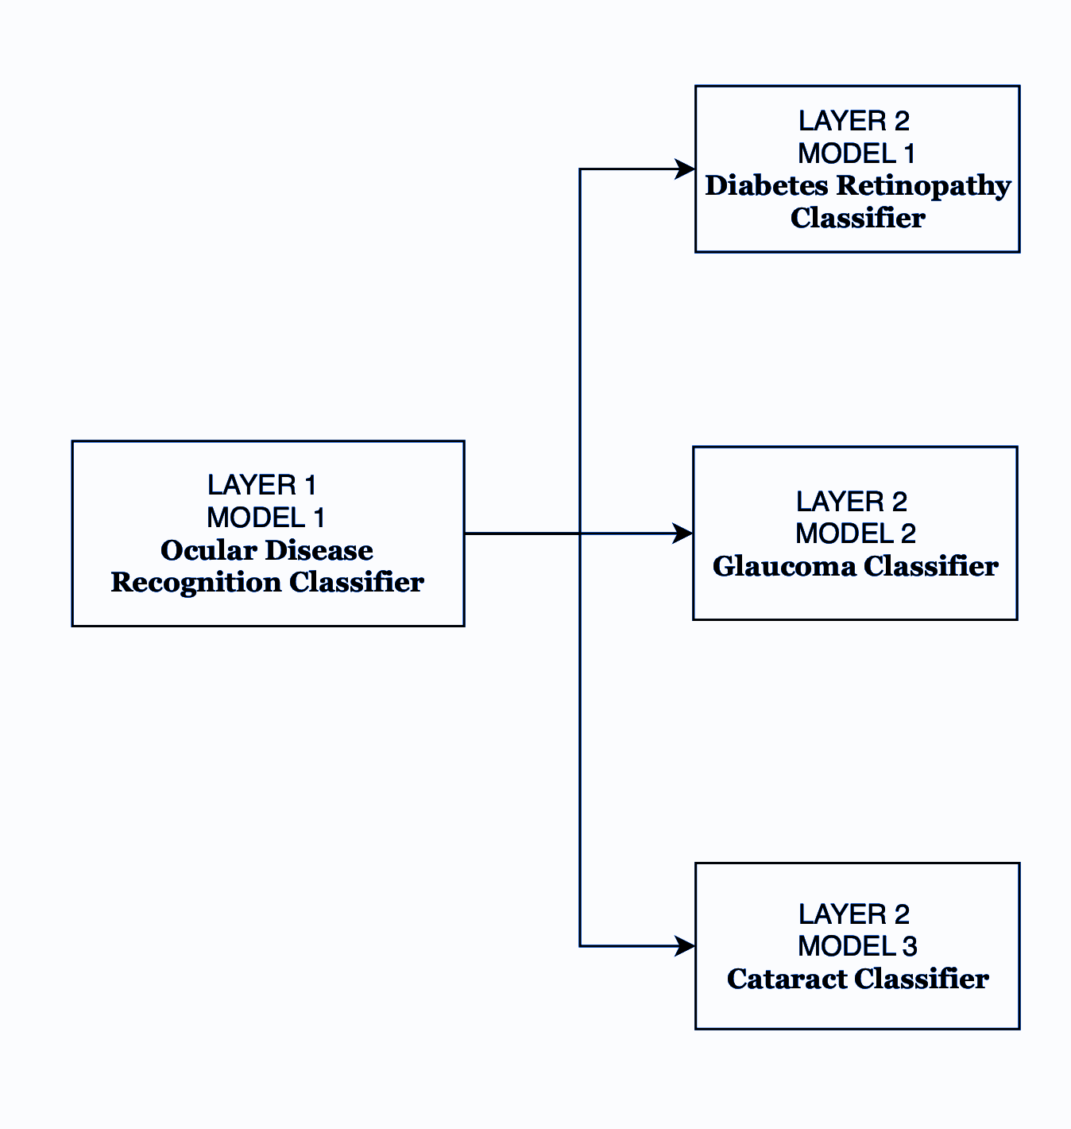
BLOCK LEVEL REPRESENTATION
Two Layers
Layer 1, #Model = 1
Layer 2, #Model = 3
Layer 1
Ocular Disease Recognition Classifier
Layer 2
Diabetes Retinopathy Classifier
Glaucoma Classifier
Cataract Classifier

Slide 4
DATA REQUIRED
4 datasets are being used in this project.
The first classifier model that classifies images into different categories of eye ailments makes use of the Ocular Disease Recognition dataset. It allows us to classify the image as normal or the presence of a disease such as DR, Cataract, Glaucoma, or other ocular conditions.
The second dataset being used is the Diabetic retinopathy dataset which allows the model to classify images into no DR, mild DR, moderate DR, severe DR, and proliferative DR.
The third dataset in use is the Glaucoma Detection Dataset which allows the model to classify images into no glaucoma and glaucoma detected.
The fourth dataset in use is the Cataract dataset which allows the model to classify images into no cataract and cataract detected

Slide 5
DATA REQUIRED
Ocular Disease Recognition Classifier dataset :
The dataset includes a csv file and image set. The csv file consists of the ID, left-fundus and right-fundus, age, gender, diagnosis, left-diagnostic keywords and right-diagnostic keywords as columns. The dataset consists of 5000 patients, with left eye and right eye images. The ODIR-5k dataset has eight output labels for classifying ocular diseases. These labels are:
Normal (N) - 4490
Diabetic Retinopathy (D) - 2520
Glaucoma (G) - 1110
Cataract (C) - 460
Age-related Macular Degeneration (A) - 440
Hypertension (H) - 420
Myopia (M) - 360
Other Diseases (O) - 200

Slide 6
DATA REQUIRED
2. Diabetes Retinopathy Classifier dataset :
This data set contains fundus of the eye.
Data set size - 4 columns x 35108 rows
Distribution of images with:
No DR - 25802
Mild DR - 2438
Moderate DR - 5288
Severe DR - 872
Proliferative DR - 708
From the first hand analysis, we can see that the dataset is heavily imbalanced across the levels of DR.

Slide 7
DATA REQUIRED
3. Glaucoma Classifier dataset :
This data set contains images/oct scans of the eye in the .jpg format.
Data set size - 5 columns x 650 rows
Distribution :
Label - With Glaucoma (168)
Label - Without Glaucoma (482)
From the first hand analysis, we can see that the dataset is heavily imbalanced.

Slide 8
DATA REQUIRED
4. Cataract Classifier dataset:
The dataset includes images of the eye that have been labeled based on the presence or absence of cataracts.
The dataset includes two main classes:
Normal: Images of eyes without cataracts.(300)
Cataract: Images of eyes with cataracts.(100)

Slide 9
TECHNICAL APPROACH
PREPROCESSING :
Rescaling : This line rescales the pixel values of the images from the original range of [0, 255] to a normalized range of [0, 1]. Neural networks typically perform better when inputs are normalized, and rescaling the pixel values helps the model converge faster during training.
Resizing : All images are resized to a fixed size. This ensures that the input dimensions are consistent for the network, which is important since neural networks require fixed input sizes.
Conversion to arrays : Images are converted into NumPy arrays to make them compatible with TensorFlow and Keras models. Each image will have three dimensions: height, width, and depth (3, for the RGB channels)
Also, the datasets for each of these classifiers are unbalanced, so undersampling method is used to make the datasets balanced.

Slide 10
TECHNICAL APPROACH
1. Layer 1 classifier - Ocular Disease recognition classifier :
For this classifier, the following models can be used :
Simple convolutional neural network (CN)
MobileNetV2 : It is a pre-trained network that is pre-trained on the ImageNet dataset, which contains millions of images classified into 1,000 categories.
ResNet : This is a transfer learning approach in which pretrained models on large datasets are fine-tuned on a smaller medical dataset.
EfficientNet

Slide 11
WORK PROGRESS
1. Layer 1 classifier - Ocular Disease recognition classifier :
Simple CNN
Accuracy : 58.9 %
PROs:
It is lightweight and efficient.
CONs:
It is not suitable when there is a lot of computation is involved as the accuracy is highly compromised.
Next step:
To achieve higher accuracy, EfficientNet and ResNET are the models that will be tried in the next approach.

Slide 12
TECHNICAL APPROACH
2. Layer 2 classifier - Diabetes Retinopathy Detection :
For this classifier, the following models can be used :
Convolutional Neural Network (CNN) architecture includes three convolutional layers (Flatten Layer, Fully Connected Dense Layer, Output Layer).
Transfer learning approaches
INceptionV3
Xception

Slide 13
WORK PROGRESS
2. Layer 2 classifier - Diabetes Retinopathy Detection :
INceptionV3
Accuracy : 74%
PROs:
widely tested in many medical imaging, making it a reliable choice with proven performance
CONs:
Although InceptionV3 is efficient, newer models like Xception may offer better accuracy
Next step:
To achieve higher accuracy, Xception is the next approach that will be tried.

Slide 14
TECHNICAL APPROACH
3. Layer 2 classifier - Glaucoma classifier :
For this classifier, the following models can be used :
VGG16 - Good starting point because of simpler architecture.
VGG19 - Slightly better than VGG16
DenseNet - Will try this to improve efficiency and accuracy.
EfficientNetB7 - Provides the best balance between computational cost and accuracy, based on transfer learning and also ideal for real world application such as this Glaucoma disease classifier.

Slide 15
WORK PROGRESS
3. Layer 2 classifier - Glaucoma classifier :
VGG16
Accuracy : 42.64 %
PROs:
Simpler architecture
CONs:
Bad accuracy, needs overfitting issue to be addressed.
Next step:
Next Better Transfer model to be tried - VGG19
Other Transfer model to be tried - DenseNet, EfficientNetB7

Slide 16
TECHNICAL APPROACH
4. Layer 2 classifier - Cataract classifier :
For cataract classifier, the following models can be used :
ResNet : This is a transfer learning approach in which pretrained models on large datasets are fine-tuned on a smaller medical dataset.
Convolutional neural network(cnn)
EfficientNet (Transfer Learning)

Slide 17
WORK PROGRESS
4. Layer 2 classifier - Cataract classifier :
Convolutional neural network(cnn)
Accuracy : 83.25 %
PROs:
It excels at understanding image data.
CONs:
The accuracy can be further improved using transfer learning.
Next step:
In the next step, ResNet and EfficientNet are the models that will be tried in the next approach.

